Slide 1

Sigurnost računala i podataka
Mario Čagalj
Sveučilište u Splitu
15.11.2011.

Slide 2
User Authentication
Computer Security: Principles and Practice
by William Stallings and Lawrie Brown
Produced by Mario Čagalj

Slide 3
User Authentication: Introduction
Protective measures (e.g., access control, accountability) make sense only if we can identify and authenticate users
Authentication validates user identity
  Often as prerequisite to allowing access to the system resources
Authentication process consists of two steps
  Identification step
    Presenting an identifier to the system (e.g., userID, username)
  Verification (authentication) step
    Presenting or generating authentication information that binds the entity presenting the identifier and the identifier itself
Distinct from message authentication

Slide 4
Means of Authentication
There are four general means of authenticating a user’s identity
  Something the user knows
    Password, personal idnetification number (PIN)
  Something the user possesses
    Smart cards, physical keys, tokens
  Something the user is (static biometrics)
    Recognition by fingerprint, face, retina, iris
  Something the user does (dynamic biometrics)
    Recognition by voice pattern, hadwriting style, typing rhythm
Can be used in combination
All have advantages and issues

Slide 5
Password-Based Authentication

Slide 6
Password Authentication
Widely used user authentication method
  User provides name/login (username) and password
  System compares password with that saved for specified login
Authenticates ID of user logging and provides security by
  Determining that the user ID is authorized to access system
  Determines the user’s privileges (e.g., admin or not)
  Is used in discretionary access control (e.g., a user owning a file may enable another entity to access this file – next lecture)

Slide 7
Password Vulnerabilities
Offline dictionary attack
  Attacker obtains system password file (with password hashes) and compares password hashes against hashes of passwords from the dictionary
Specific account attack
  Submit candidate passwords until the correct password discovered or until the account is locked (e.g., after 3 failed attempts)
Popular password attack
  Try popular passwords against a range of user IDs
Password guessing against single user
  Make educated guesses based on knowledge about the user (age, gender, marital status, ...)

Slide 8
Password Vulnerabilities
Workstation hijacking
  Steal unlocked workstation and use e.g. Cain&Abel to recover the password
Exploiting user mistakes
  Passwords written down, shared, social engineering
Exploiting multiple password use
  Password reuse problem (due to cognitive overload)
Electronic monitoring
  Intercept passwords communicated across a network (simple and naive encryption does not help here)

Slide 9
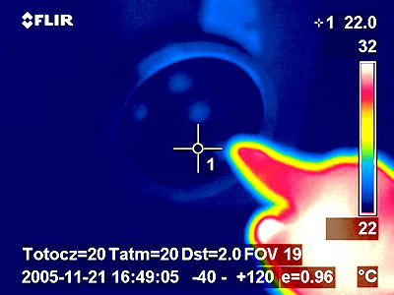
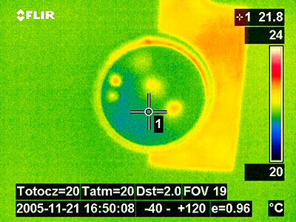
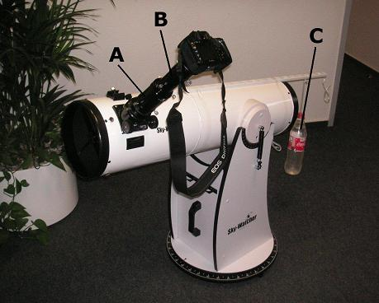
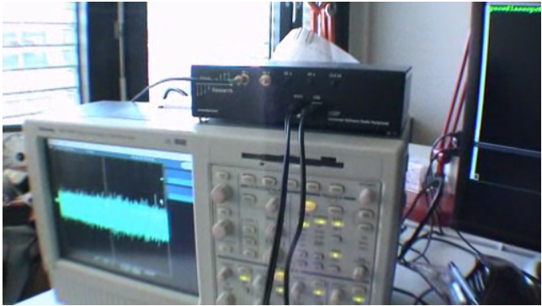
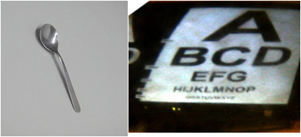
Password Vulnerabilities: Examples
Watch this video http://vimeo.com/2007855
(Compromising EM Emanations of Keyboards)
Oakland - [Backes2008]

Slide 10
Storing Passwords
Passwords are never stored in clear text
  The risk of theft would be great
Instead, a hash of a password is stored
  Recall, hashing is a one-way function which gives a unique and unreversable result (hash value, message digest)
  If a user provedes a correct password, its hash must be identical to the hash stored (previously) in the password file
Password-based authentication in Unix and Windows
Cleartext password
Password file
One-way function
(e.g., hash or encryption)
User ID
“Hashed” password

Slide 11
Passwords in Unix

Slide 12
Unix Password Scheme
To load (create) a new password into the system
  The user selects or is assigned a password
  This password is combined with a fixed-length salt value
Salt
Password
Password file
User ID | Salt | Hash value
Bob | 7a | ri79KNd7v6.Sk
Slow hash
function
Loading a new
password
Load
User ID
Password file
User ID | Salt | Hash value
Bob | 7a | ri79KNd7v6.Sk
Salt
Password
Select
Slow hash
function
Verifying a
password
Compare
Hash value

Slide 13
Unix Password Scheme: Salt Values
Offline dictionary attack
  Assume: the goal is to guess a single pwd & salt not used
  Attacker obtains a copy of the password file
  Attacker hashes likely candidate passwords and compare obtained hash values with the ones in the password file
  If any of the guesses matches one of the hashes in the file, the attacker has found a password that is in the file
The salt value serves three purposes
  Prevents duplicate passwords to be visible in password file
  Increases difficulty of offline dictionary attacks (k bits salt increases guessing load by a factor of ~2^{k})
  Not possible to find out whether a user with passwords on two or more systems has used the same passwords on all of them

Slide 14
Unix Hashed Pwd Implementation
The original scheme (crypt(3) routine)
  8 character password form 56-bit secret key
  12-bit salt perturbs DES encryption algorithm in one of 4096 different ways
  0 value repeatedly encrypted 25 times (slows down guesses)
  Output translated to 11 character sequence
Salt
12 bits (2 characters)
am
pwd | salt | crypt(3) hash
test | am | hiOY1vb4nIE
test | ri | j.uEL2QOTHU
test | 7a | FB/N4.DacNU
Zeros
64 bits
DES
hiOY1vb4nIE
Hash
64 bits (11 chars)
test
56 bits (up to 8 characters,
only 7 bits of each char is taken)

Slide 15
Unix Password Hashes
crypt(3)-based implementation is inadequate today
  8 chars (i.e., 56 bits) are are simply too few
  Dictionary attack investigated using the Blue Horizon supercomputer
    Precomputed and stored 207 billion hashes (~1.5 TB) for over 50 milion passwords in about 80 min (207 x 10⁹ / 50 x 10⁶ approx. 4096 – #salt values)
Time-memory tradeoffs
  Effective when salt is not used (Oechslin’03 showed that using 1.4GB of data – rainbow tables - Windows LM hashes broken in <14 sec)
Better hashes for Unix
  Modern Unix systems based on MD5 hashes instead of DES hashes
  Advantages:
    Passwords can have more than 8 characters
    Produces 128 bit hash values
    Longer salt values (48 bits)
    “Very” slow (1000 inner loops)

Slide 16
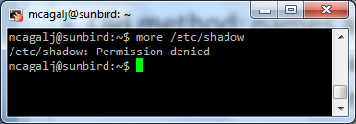
Password File Access Control
Old method: names and hashes are stored in /etc/passwd
  Free for anybody to read
  Opens up for easy offline dictionary attack
Safer method: the hashes stored in separate file /etc/shadow
  Only root can access to this file
Theft of Unix Hashes
  Goal: gain access to /etc/shadow
  Boot the machine on a CD
  Obtain root privileges (e.g., by using an exploit)
root:x:0:0:root:/root:/bin/bash
mcagalj:x:1001:1001:,,,:/home/mcagalj:/bin/bash
root:aQtsvOTXjNRbY:10919
mcagalj:HYy0b0xFEWIZw:10919:

Slide 17
Logon and Authentication in Windows

Slide 18
Logon Authentication Scenarios
There are four types of logon processes in Windows 2000, Windows Server 2003/08 and Windows XP Professional
  Interactive logon
    Logs on to a local computer to which you have direct physical access (includes terminal services and remote desktop logon processes)
  Network logon
    Controls access to a system running different Windows operating systems across the network from the computer where you logged on
  Service
    Authenticates and autheorizes different Windows services
  Batch
    Reserved for batch jobs (e.g., big print spools, bank account reconciliation); rarely used

Slide 19
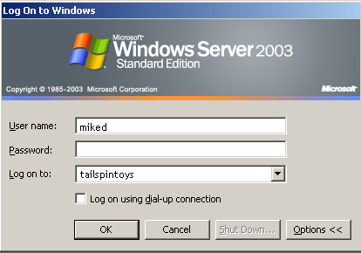
Interactive Logon: Windows Server 2003
Interactive logon begin with the secure attention sequence CTRL+ALT+DEL
  GINA DLL generates logon dialog box
  User logs on using either local or domain account
  User enters user name and password (alternatively,
  a smart card- requires external device- and PIN)
Local logon
  Authorizes access to local computer and resources
  Security Account Manager (SAM) DB holds account info (e.g., pwd hashes)
Domain logon
  Give access to domain resources; account info in Active Directory domain
Single Sign On (SSO) – one time logon
Cached Credentials – once successfully authenticated, allows access to resources even when the domain controller not avaliable

Slide 20
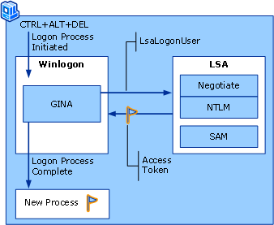
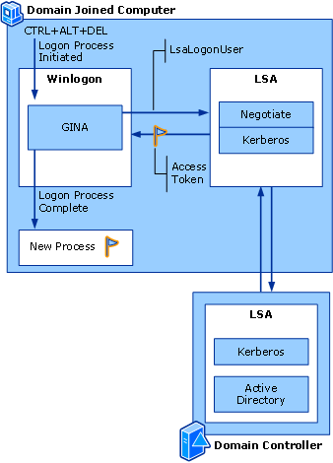
Interactive Local and Domain Logon
Local logon
LSA: Local Security Authority
Domain logon

Slide 21
Local Security Authority (LSA)
LSA is a Windows security subsystem that authenticates and logs users on to the local computer
  Manages local security policy
    E.g., which domains are trusted, who can have access to the system, who is assigned what rights, what security auditing is performed
  Provides interactive user authentication services
  Generates access tokens
  Manages the audit policy

Slide 22
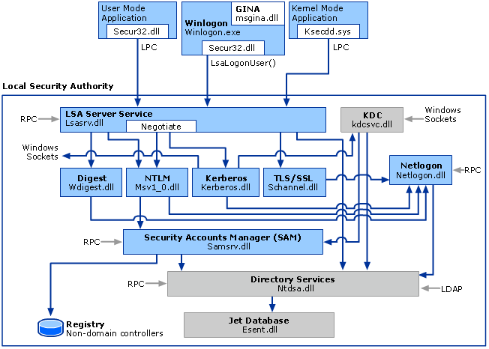
LSA Architecture
DLLs responsible for individual authentication mechanisms
  NTLM (Msv1_0.dll)
  Digest (Wdigest.dll)
  Kerberos (Kerberos.dll)
  TSL/SSL (Schannel.dll)

Slide 23
Primary Authentication Protocols in WinNT4.0, WinXP Pro, Win2K, WinSrv03
Microsoft Windows supports various methods to authenticate a user (or a computer)
  Kerberos protocol is the core
    Since the introduction of Windows 2000
    Enables mutual authentication between client (user,computer,service) and server
    Secure and scalable
    LSA acts as a proxy between a client and Kerberos Key Distribution Service (KDS) that issues service granting tickets to the client
  NTLM protocol (3 methods of challenge/response authentication)
    Default in WindowsNT 4.0, also included in WinSrv03 for compatibility with versions earlier than Windows 2000
    LAN Manager (LM)
    NTLM version 1
    NTLM version 2
In this lecture we focus on (in)security of NTLM protocol

Slide 24
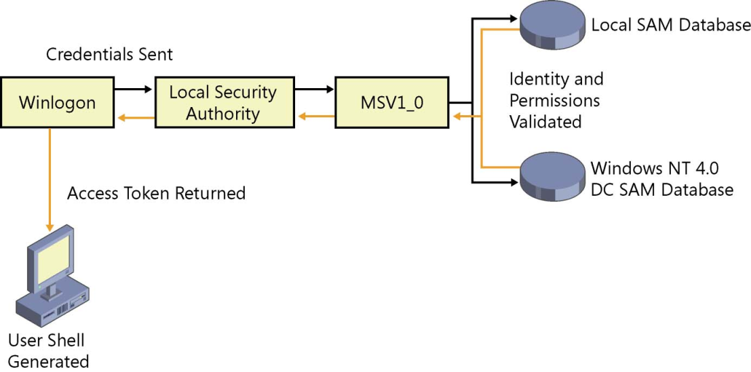
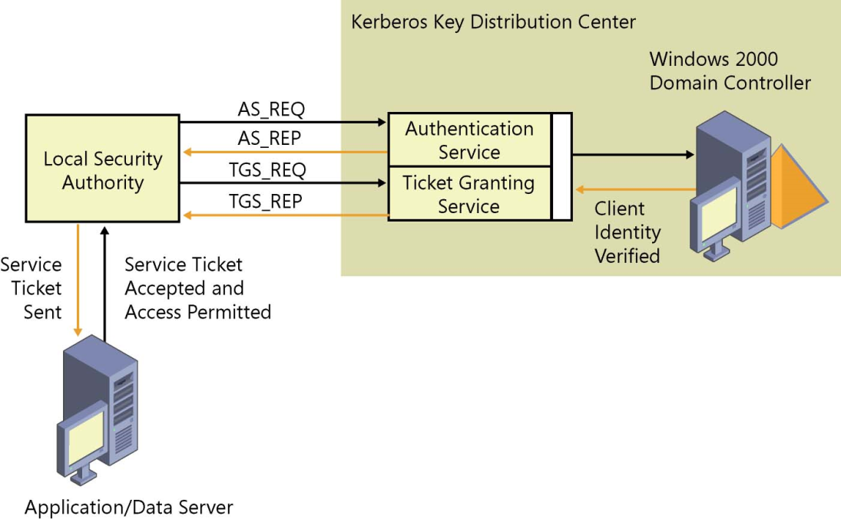
NTLM vs Kerberos Login Process
NTLM:
Kerberos:

Slide 25
NTLM: LM Hash (e.g., in WinXP)
LM authentication based on weak cryptographic procedures
  User ASCII password converted to uppercase
  Password null-padded or truncated to 14 bytes
  The “fixed-length” password is split into two 7-byte halves
  These two values are used to create two DES keys
    One from each 7-byte half, by converting the seven bytes into a bit stream, and inserting a null bit after every seven bits (so 1010100 becomes 01010100); this generates the 64 bits needed for the DES key.
  Each of these keys is used to DES-encrypt the constant ASCII string KGS!@#$%, resulting in two 8-byte ciphertext values
  These two ciphertext values are concatenated to form a 16-byte value, which is the LM hash
The resulting LM hash stored in the SAM (Security Accounts Manager) database (locally or at the domain controller)

Slide 26
NTLM: LM Hash Insecurity
Password characters are restricted to the ANSI printable character set (95 characters)
Passwords longer than 7 characters are divided into two pieces and each piece is hashed separately (truncated to 14 bytes)
Brute-force complexity
  There are 95¹⁴ ~ 2⁹² passwords with 14 printable characters
  But, 95⁷ ~ 2⁴⁶ passwords with 7 printable characters (one half)
  Only uppercase characters used 69⁷ ~ 2⁴³ (breakable in few hours!)
LM hash does not include salt, therefore a time-memory trade-off cryptanalysis attack, such as rainbow tables, is also feasible
  TMTO-based attacks break LM hashes in matter of seconds!
  0phcrack, Cain&Abel

Slide 27
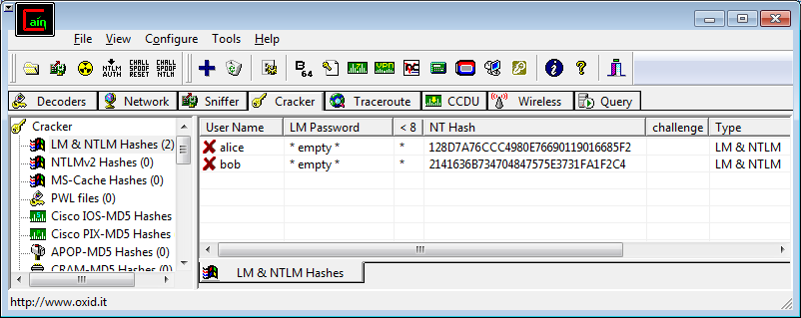
NTLM: NTLM version 1
NTLMv1 developed to replace the weaker LAN Manager
  Take a password (respects upper and lowercase)
  Calculate the MD4 of it – 128 random bits (16 bytes)
    2⁹² passwords with 14 printable characters
  Store this value – NTLM Hash

Slide 28
NTLM: Network Login with NTLMv1
Used to authenticate
  Web site users, file share access, printer access, RPC calls, etc.
Challenge-response authentication
  Domain controller (server) sends a random challenge to the workstation of the user
  The workstation encrypts the challenge with the NTLM hash of the password and sends it to the controller (server)
  The controller does the same operation using the NTLM hash stored locally and compares the results

Slide 29
NTLMv1 Challenge/Response Details
How NTLM Hash & Challenge → NTLMv1 Response
MD4 of password=0x0123456789ABCDEFFEDCBA9876543210
→Broken into three “Key Chunks”
→ Key 1: 0123456789ABCD
→ Key 2: EFFEDCBA987654
→ Key 3: 32100000000000
NTLMv1 Response =
DES(Key1, Challenge) + DES(Key2, Challenge) + DES(Key3, Challenge)

Slide 30
NTLMv1: Some Security Issues
Response generation requires only the NTLM Hash (the password authenticator)
  NTLM Hash is password equivalent (not the case in Unix - salt)
  NTLM Hash exposure is therefore catastrophic → login without pwd!
Weak DES cipher is used
  Effort to try all DES keys: 2 x 2⁵⁶+2¹⁶ ~ 2⁵⁷ for all three portions of the NTLM Response
  10 character alphabetic mixed case password has about 2⁵⁷ possibilities
  Therefore for longer passwords, easier to bruteforce DES
Active man-in-the-middle
  Attacker provides known challenge and launch pre-computed dictionary attacks

Slide 31
NTLMv1: Other Shortcomings in Windows NT/2k
By default NT workstations send two responses to the challenges
  One using NTLM Hash
  One using LM Hash (for backward compatibility)!

Slide 32
NTLM: NTLM version 2
NTLMv2 significantly improves authentication of NTLM
NTLMv2 Challenge/Response Details
  Both client and server generate random challenges
CS = 8-byte server challenge, random
CC = 8-byte client challenge, random
CC* = (X, time, CC, domain name)
  Calculate NTLMv2 Response
  v2-Hash = HMAC-MD5(NTLM Hash, user name, domain)
  NTv2 = HMAC-MD5(v2-Hash, CS, CC*)
NTLMv2 Response = CC | NTv2 | CC*
Prevents pre-computed
dictionary attacks
MD4 hash of
a password

Slide 33
LM, NTLMv1 and NTLMv2 Comparison
 | LM | NTLMv1 | NTLMv2
Password case sensitive | No | Yes | Yes
Hash key length | 56 + 56 bit | - | -
Password hash algorithm | DES (ECB mode) | MD4 | MD4
Hash value length | 64 + 64 bit | 128 bit | 128 bit
Chall.-Resp. key length | 56 + 56 + 16 bit | 56 + 56 +16 bit | 128 bit
Chall.-Resp. algorithm | DES (ECB mode) | DES (ECB mode) | HMAC_MD5
Chall.-Resp. value length | 64 + 64 + 64 bit | 64 + 64 + 64 bit | 128 bit

Slide 34
From Windows 2000 on - Network Login
In a native W2k enviroment, the Kerberos protocol is used to carry out network logins
Kerberos authenticates both the user and the server (no more man-in-the-middle attacks)
  The user is authenticated by the NTLM hash of the password
  The server is authenticated by a password known by all workstations in the given domain
The user is issued lifetime limited access tickets
  One Ticket-Granting-Ticket (TGT)
  Many service tickets using TGT
  No need of re-authentication to access a service as long as TGT is valid (single sign-on)
Kerberos protocol is very secure

Slide 35
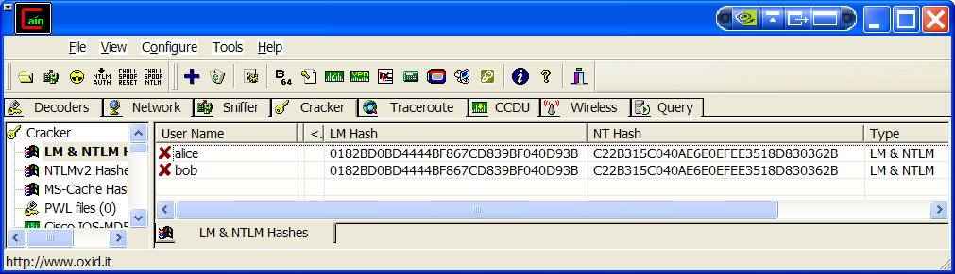
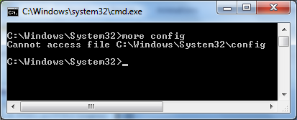
Storing of Hashes in NT and 2k
The NTLM and LM hashes of all users are stored in the SAM file or in the Active Directory (ntds.dit)
Since W2k SP2 it is possible to deactivate LM hash generation
The file containing the hashes is locked by the kernel at startup
  Can be stored at several
  locations!
WinXP Profess.
(Win7 on slide 27)

Slide 36
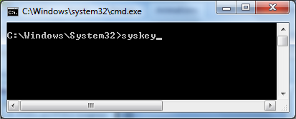
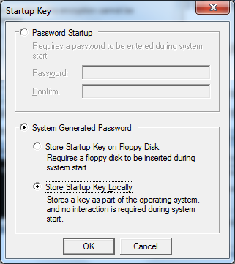
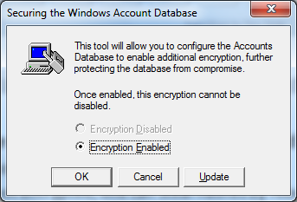
Storing of Hashes in NT and 2k
Since NT SP3 the SAM can be encrypted (default in W2k)
  Microsoft©Syskey utility
  If not encrypted, one can steal hashes by rebooting from CD
  If encrypted, administrator rights are needed to steal the hashes (using a tool like pwdump)

Slide 37
Protective Measures(Administrator)
Use only pure Unix or Win2k or higher networks
Deactivate LM hash generation (e.g., Win7)
Secure the file containing the hashes
  Windows: use syskey utility
  Unix: use /etc/shadow
Use Kerberos protocol whenever possible
Restrict physical access to servers containing hashes
Apply all latest security patches and service packs
Apply tools that force users to chose strong passwords
Audit the passwords regularly

Slide 38
Security Tokens
9.11.2010.

Slide 39
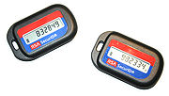
Security Tokens (something you have)
Objects that a user possesses for the purpose of user authentication are called (authentication) tokens
The system can verify that a user owns a unique token
Two-factor authentication
  E.g. the combination of a password (something you know) and a token (something you have) considerably increases security
Examples:
  Scratch lists
  SecureID tokens (display a new 6 digit number every minute)
  Calculators
  Magnetic and smart cards

Slide 40
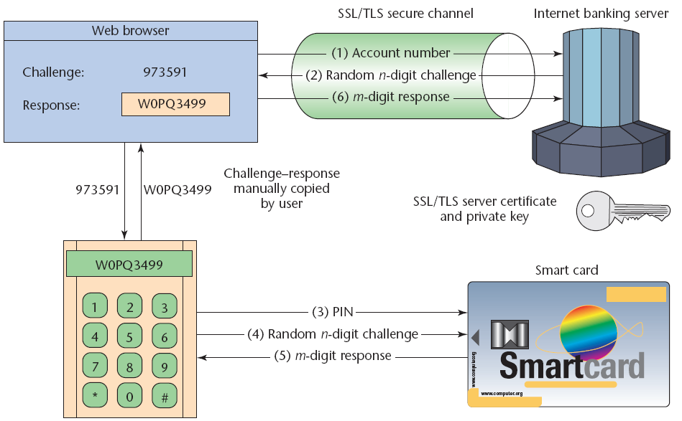
Example: Secure Internet Banking
Hiltgen et al. “Secure Internet Banking Authentication”, IEEE Security & Privacy, 2006
Offline card reader
User knows
User owns

Slide 41
Biometric Authentication
9.11.2010.

Slide 42
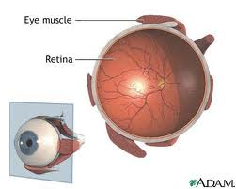
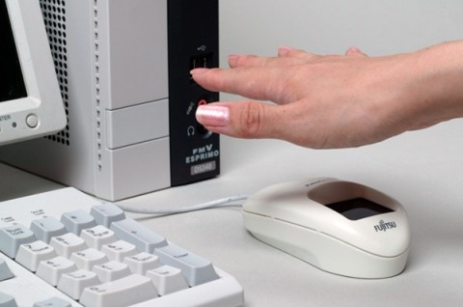
Biometrics (something you are)
Science of measuring physical characteristics of human beings
A biometric authentication system attempts to authenticate an individual based on unique physical characteristics
Human physical characteristics
  Fingerprint
  Shape of a hand
  Iris
  Retina
  DNA
  Face...
Human behavior
  Dynamics of signature (speed, preasure, direction)
  Voice
  Keyboard usage

Slide 43
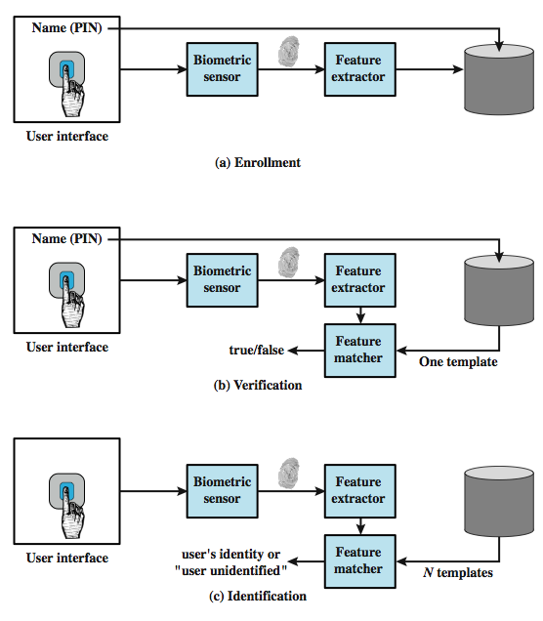
Operation of a Biometric System

Slide 44
Biometric Accuracy
Biometric system
  Physical characteristics of the user mapped into a digital representation
  For each user a single representation (template) stored in the computer
  When user is to be authenticated, the system compared stored template to the presented template
  Given the complexities of physical characteristics, we cannot expect the exact match between the two templates
  Therefore, the system uses algorithms to evaluate a matching score (e.g., expresses as a single number)
It is hard to create a perfect biometric system
  Too sensitive → too many false negatives (false nonmatch)
  Unsensitive → too many false positives (false match)

Slide 45
Biometric Accuracy
Biometric system
  Physical characteristics of the user mapped into a digital representation
  For each user a single representation (template) stored in the computer
  When user is to be authenticated, the system compared stored template to the presented template
  Given the complexities of physical characteristics, we cannot expect the exact match between the two templates (not possible to hash)
  Therefore, the system uses algorithms to evaluate a matching (similarity) score (e.g., expresses as a single number) between the two templates
The problem: the similarity score will vary over different authentication sessions for the given user
Basic question: how to set the sensitivity of the system?
  E.g., what the threshold similarity score should be in order to grant the user an access to the system?

Slide 46
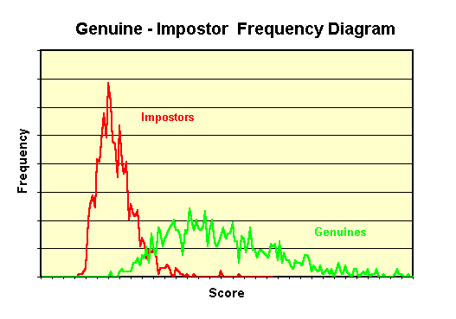
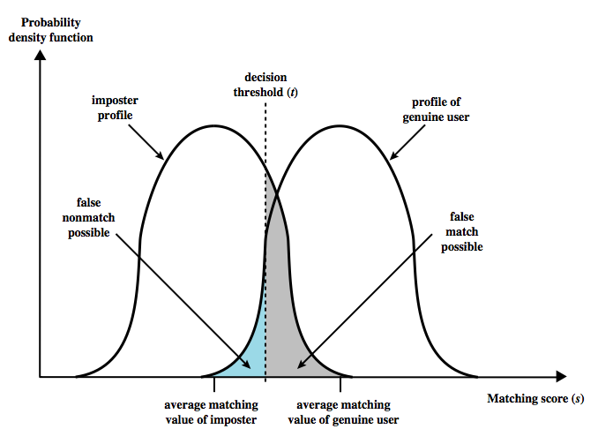
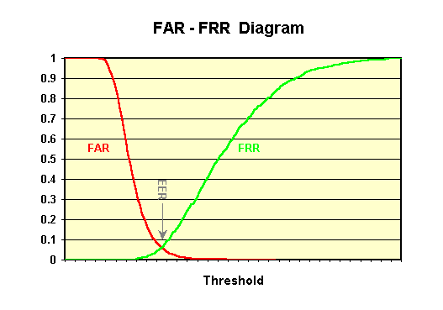
Biometric Accuracy
Too sensitive → too many false negatives (false nonmatch, reject)
Unsensitive → too many false positives (false match, accept)
By decreasing one, the other increases (and vice versa)
http://www.bromba.com/faq/biofaqe.htm

Slide 47
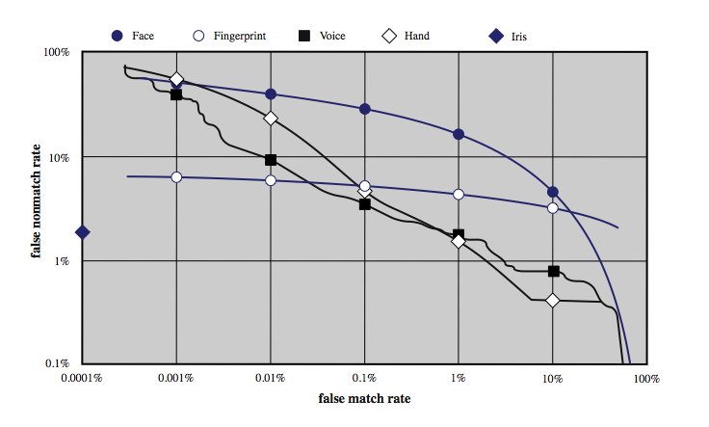
Biometric Accuracy
For a given biometric scheme, we can plot the false match versus false non-match rate, called the operating characteristic curve
How to pick a threshold matching score depends on application
  E.g., pick a threshold that corresponds to the point on the curve where
  false positive rate = false negative rate
NOTE: Logarithmic scale is used.
Equal Error Rate

Slide 48
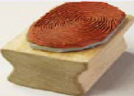
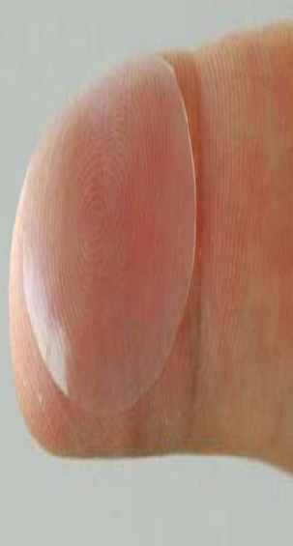
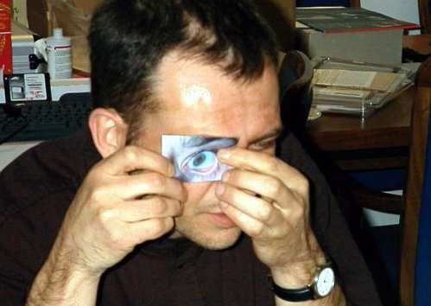
Biometric Discussion
Shortcomings
  Information is never identical → not possible to hash (neither for storage nor for storage)
  Risk of theft
  Not possible to change a stolen finger
  Some scanners can be fooled or replaced
Ideal applications
  Physical access control
  Authentication for payments at a cash register

